Slide 1
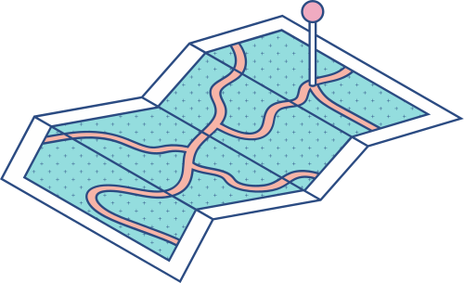





Object-Oriented Programming Project Presentation: Implementing Bracketing Methods in finding roots of an eqaution
(BISECTION AND FALSE-POSITION METHOD)

Slide 2

Introduction
In various fields such as engineering, physics, finance, and computer science, the search for solutions to equations is widespread. Two well-known methods for narrowing down these solutions within given ranges are the false position method and the bisection method. In this research, we focus on applying these methods in Java, leveraging its versatility and object-oriented approach, to create effective algorithms for finding roots numerically. By delving into the details of implementation, computational considerations, and performance analysis, we aim to explain how these methods can be practically useful, efficient in computation, and stable in numerical terms. This exploration will shed light on their advantages, limitations, and real-world uses.

Slide 3

Objectives
1. Develop Java code capable of implementing both the False Position Method and the Bisection Method, offering users versatile tools for solving equations efficiently and accurately.
2. Create algorithms within the Java codebase that efficiently approximate roots within specified intervals, prioritizing performance optimization and minimizing computational overhead to enhance speed and efficiency.
3. Conduct comprehensive testing and analysis within the code to assess the practical utility and numerical stability of the implemented methods. Ensure accuracy and reliability across diverse equations and intervals, validating their effectiveness in real-world scenarios
4. Perform a comparison of the False Position Method and the Bisection Method within the code, evaluating their convergence speed, computational efficiency, and robustness. Provide insights into the relative strengths and weaknesses of each method to guide users in selecting the most suitable approach for their specific requirements.
5. Provide users with insights into the strengths, limitations, and applicability of each method within the codebase. Offer guidance on when to utilize each method effectively in various problem-solving contexts, empowering users to make informed decisions based on the specific requirements of their tasks.

Slide 4
Overview
Root finding is a fundamental problem in mathematics and computer science, often encountered in various scientific and engineering applications. This application simplifies the process of finding roots by providing an intuitive GUI where users can input a function, specify bounds, choose a root-finding method, and view the results in a table format.

Slide 5
Features
User-friendly GUI: Intuitive graphical interface for inputting function parameters and viewing results.
Bisection Method: Compute roots using the Bisection Method, a simple and robust numerical method for finding roots of continuous functions.
False Position Method: Compute roots using the False Position Method, also known as the Regula Falsi method, which is a more sophisticated variant of the Bisection Method.
Table Display: Results displayed in a tabular format, including method used, iteration number, bounds, mid-point, function values at bounds and mid-point, and percent error.
Customization: Users can specify the maximum number of iterations for the root-finding process.

Slide 6
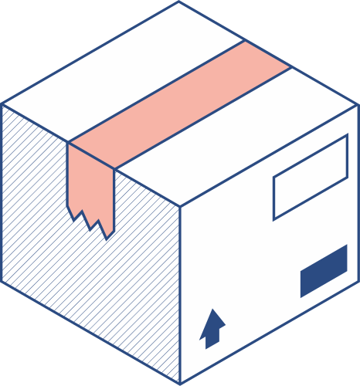
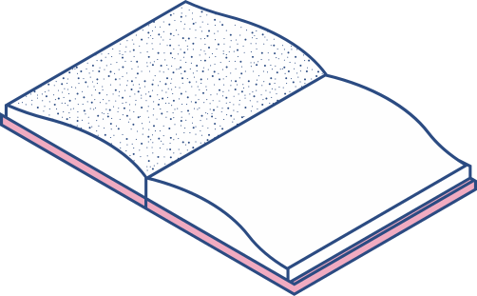

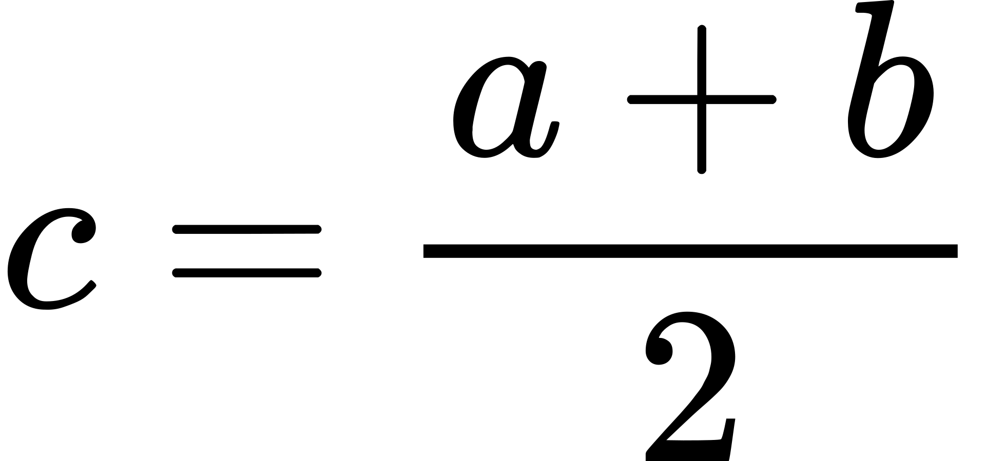
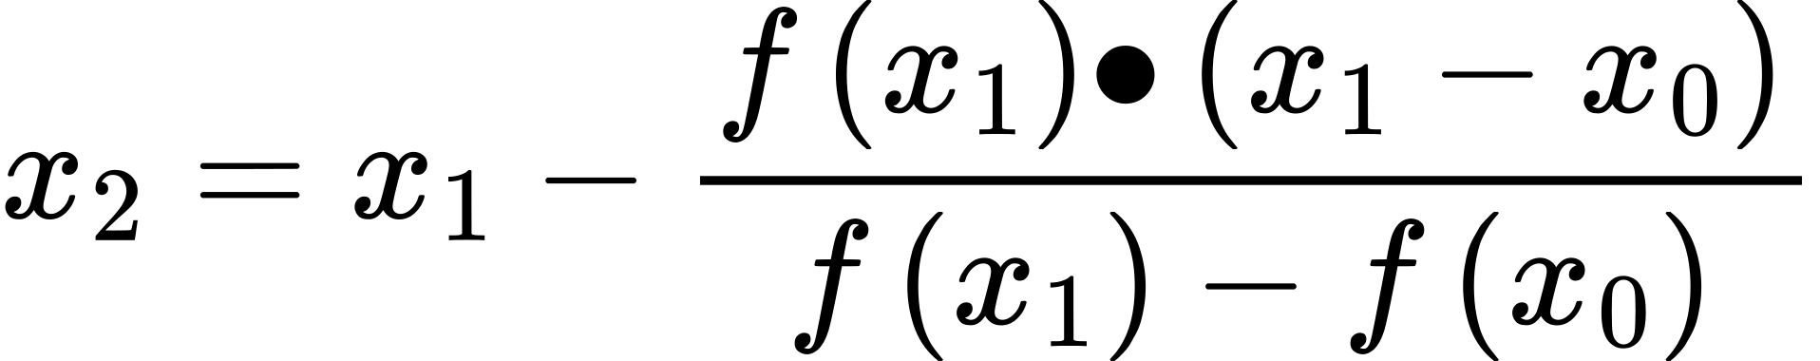
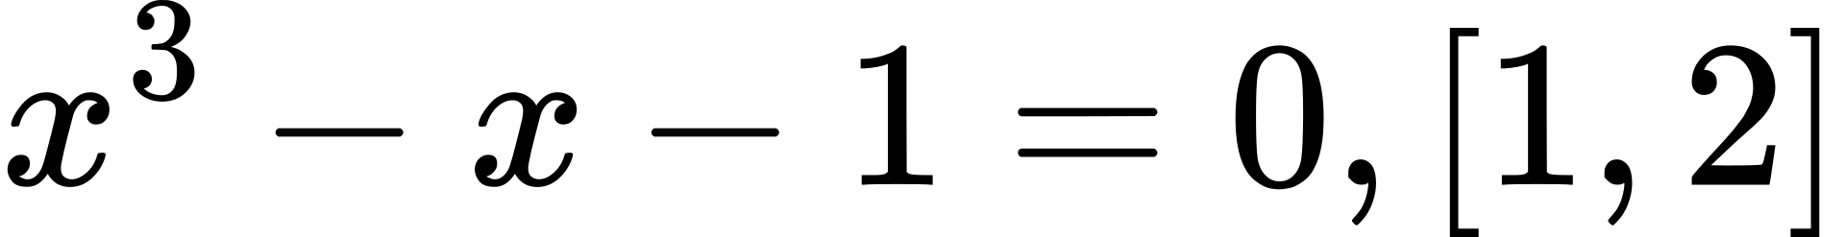
Bisection | False position
The Bisection Method is a numerical technique used to find the root of a continuous function within a given interval. It repeatedly bisects the interval and selects the subinterval where the function changes sign, thus narrowing down the root. Formula: where: a and b are endpoints of the interval, c is the midpoint of the interval Example function | The False Position Method, also known as the reguli falsi method, is a numerical technique used to find the root of a continuous function within a given interval. It’s simular to the bisection method but uses linear interpolation instead of interval halving. By iteratively refining estimates baseed on the functin’s sign changes within the interval, it converges to the root. Formula: where: x0 and x1 are initial guesses for the root, f(x0)and f(x1) are the function values at the initial guesses, f(x2)is the function value at the next approximation Example function

Slide 7
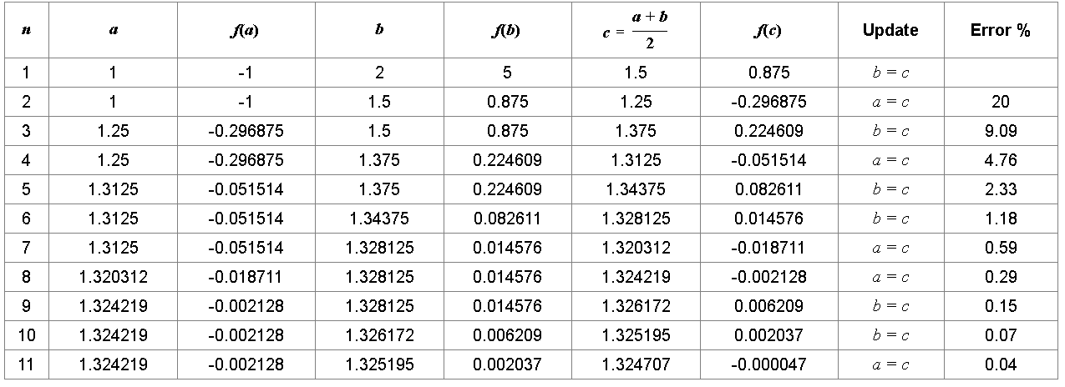
Bisection

Slide 8
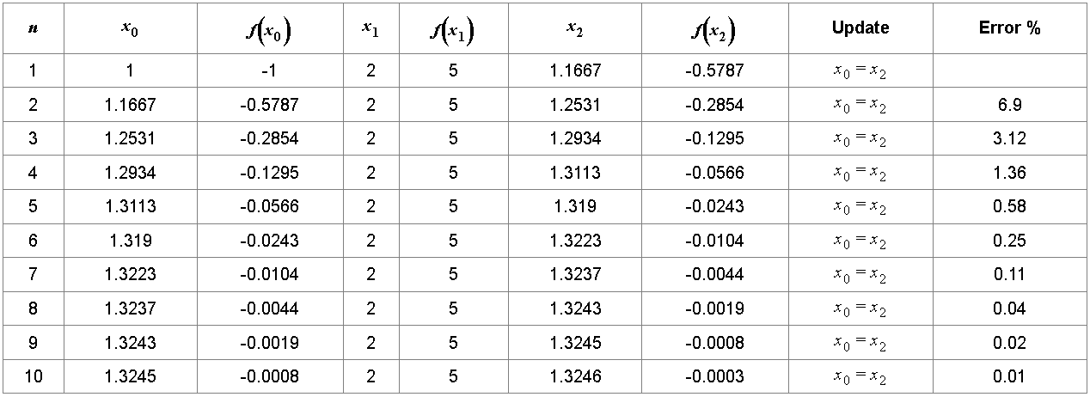
False Position Method

Slide 9

SDG (Sustainable Development Goal's)
1.QUALITY EDUCATION - THIS PROJECT CONTRIBUTES FOR PROVIDING A TOOL THAT CAN BE USED FOR EDUCATIONAL PURPOSES, HELPING STUDENTS AND LEARN UNDERSTAND, AND APPLY NUMERICAL METHODS FOR SOLVING EQUATIONS.
2. INDUSTRY, INNOVATION, AND INFRASTRUCTURE - THIS PROJECT PROMOTES INNOVATION BY PROVIDING A SOFTWARE TOOL THAT UTILIZES NUMERICAL METHODS FOR SOLVING MATHEMATICAL PROBLEMS, CONTRIBUTING TO THE ADVANCEMENT OF TECHNOLOGY IN THE FIELD OF COMPUTATIONAL MATHEMATICS
.
3. RESPONSIBLE CONSUMPTION AND PRODUCTION - THIS PROJECT PROMOTES RESPONSIBLE CONSUMPTION BY PROVIDING A SOFTWARE TOOL THAT ALLOWS USERS TO EFFICIENTLY SOLVE MATHEMATICAL PROBLEMS, POTENTIALLY REDUCING THE NEED FOR PAPER-BASED CALCULATIONS AND MINIMIZING RESOURCE CONSUMPTION.

Slide 10
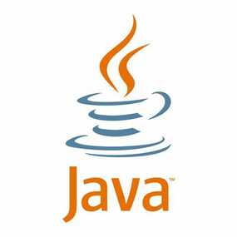
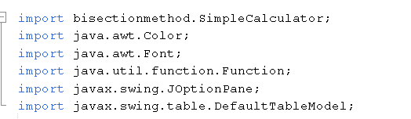
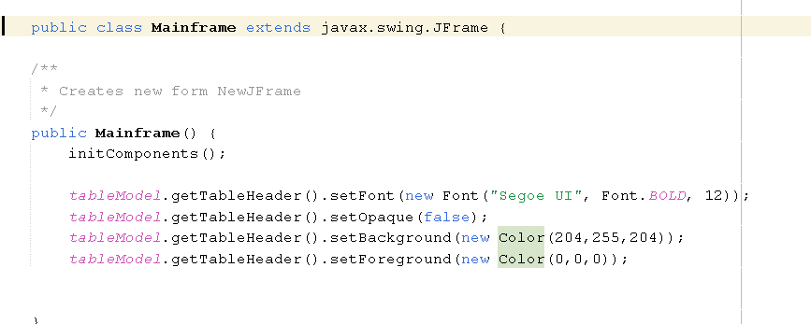
Code
imports
Mainframe(): This is the constructor of the Mainframe class. It initializes the components of the GUI (Graphical User Interface) using the initComponents() method.

Slide 11
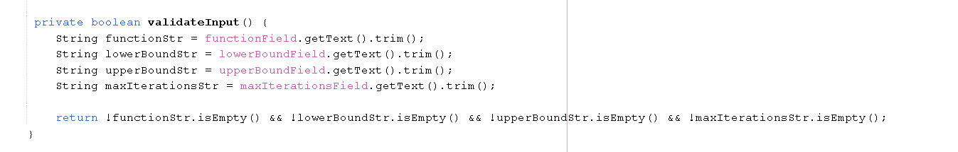
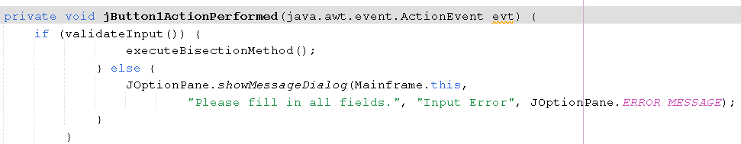
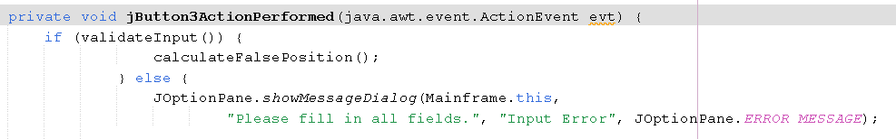
Code
validateInput(): This method checks whether the input fields (function, lower bound, upper bound, and max iterations) are filled. It returns true if all fields are filled, otherwise false.

Slide 12
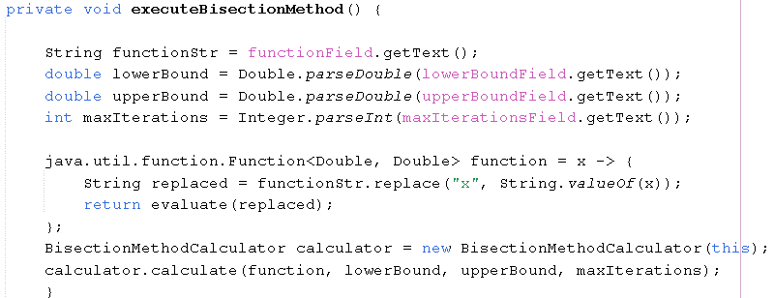
Code
executeBisectionMethod(): This method is called when the user clicks the "CALCULATE (BISECTION METHOD)" button. It retrieves the input values, converts the function string to a lambda function, and then calls the BisectionMethodCalculator to perform the bisection method calculation.

Slide 13
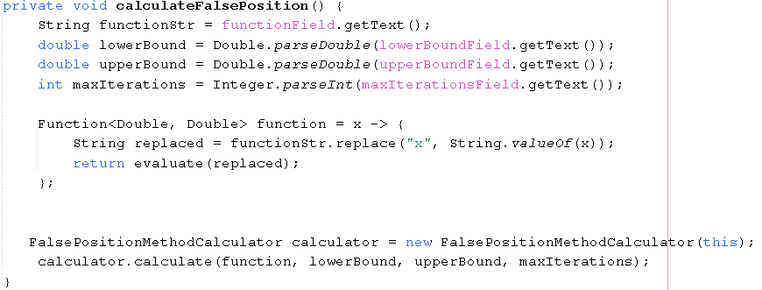
Code
calculateFalsePosition(): This method is called when the user clicks the "CALCULATE FALSE POSITION" button. It performs similar tasks to executeBisectionMethod() but using the FalsePositionMethodCalculator.

Slide 14

Code
evaluate(): This method takes a mathematical expression as a string and evaluates it using the SimpleCalculator class, returning the result.

Slide 15
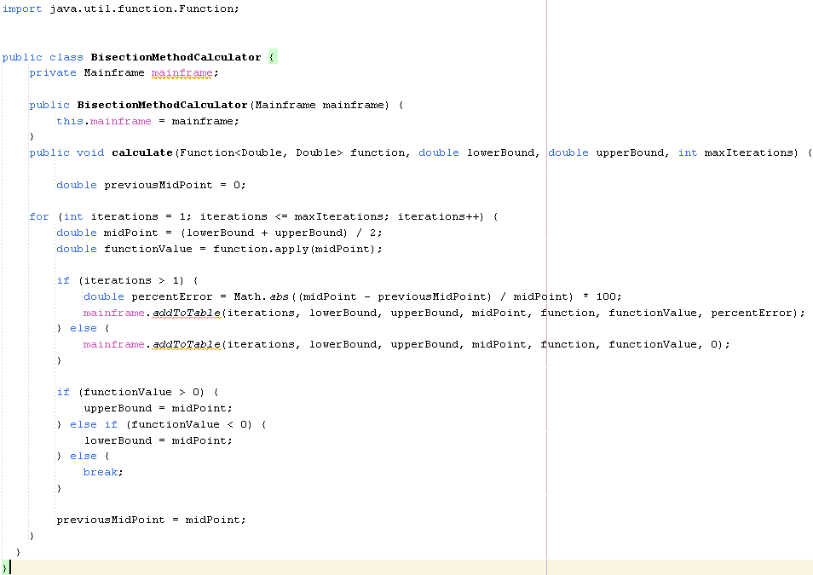
Code
This class implements the bisection method for finding the root of a function within a specified interval and updates the Mainframe GUI with each iteration's results.

Slide 16
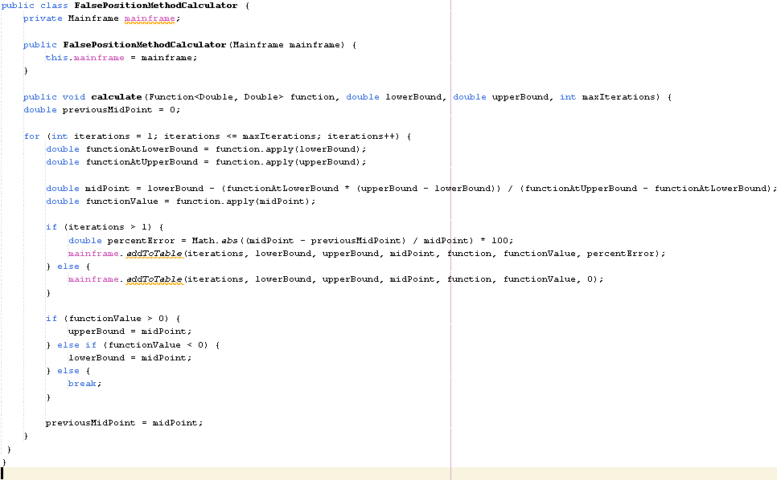
Code
This class implements the false position method for finding the root of a function within a specified interval and updates the Mainframe GUI with each iteration's results.

Slide 17
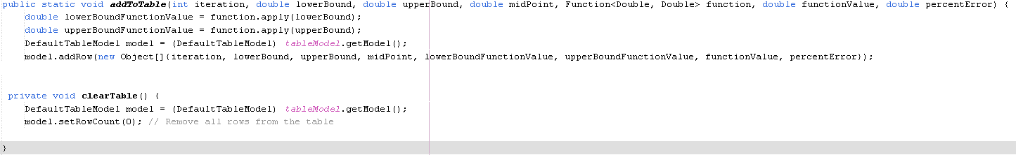
Code
The addToTable method adds a new row to the table model, containing iteration number, lower bound, upper bound, mid-point, function values at lower and upper bounds, function value at mid-point, and percent error, using the input parameters provided.
The clearTable method removes all rows from the table model, effectively clearing the table.

Slide 18

4 Pillars Of Object-Oriented Programming we Implemented
Encapsulation - In this project, the provided classes such as Mainframe, SimpleCalculator, BisectionMethodCalculator, and FalsePositionMethodCalculator encapsulate their data and methods, providing a clear interface for interacting with their functionality
Abstraction - In our code, the class represents specific components of the numerical computation tool, abstracting away the implementation details and exposing only the necessary methods and interfaces for interaction.
Inheritance - this pillar is not directly inherited by other classes but they are associated with the mainframe class. They receive a reference to the mainframe instance in their constructors, enabling them to interact with the mainframe-class. But surely, by extending Jframe, the mainframe-class inherits all properties and methods of the Jframe class.
polymorphism - Both BisectionMethodCalculator and FalsepositionCalculator allow instances to be treated uniformly as Calculator objects. The Mainframe class can interact with these calculator objects without needing to know the specific types, promoting flexible code reuse.

Slide 19

DEMONSTRATION

Slide 20

Thank You!!!

Slide 21

REFERENCES
THANK YOU
Kaw, Autar K., and Egwu Eric Kalu. "Bisection Methods for Solving a Nonlinear Equation." Numerical Methods with Applications. LibreTexts, 15 Feb. 2018.https://math.libretexts.org/Workbench/Numerical_Methods_with_Applications_(Kaw)/3%3A_Nonlinear_Equations/3.03%3A_Bisection_Methods_for_Solving_a_Nonlinear_Equation
Prykhodko, Oleksandr. "Four Pillars of Object-Oriented Programming." freeCodeCamp.org, freeCodeCamp, 21 Dec. 2020. https://www.freecodecamp.org/news/four-pillars-of-object-oriented-programming/
mycodeschool. "Introduction to Polymorphism in C++ (Hindi)." YouTube, uploaded by mycodeschool, 8 Aug. 2013.https://www.youtube.com/watch?v=YykJGqvpFnU&t=921s

